Slide 1
NATIONAL COMPETITION POLICY
GROUP - 6

Slide 2
GROUP MEMBERS
Amit Kumar
Benjamin Karunakaran
Gaikhonlung Panmei
Himanshu
Kandarp Vajubhai Patel
Nishant Narayan
Pavan Kumar
Dr Prashant Chauhan
Richa Gulati
Sanath Kumar N.

Slide 3
FAIR COMPETITION ?
Notes:
A cartoon to show depict a case of unfair competition

Slide 4
COMPETITION
Competition refers to a situation in a market place in which firms/entities or sellers Independently strive for the patronage of buyers in order to achieve a particular business Objective, such as profits, sales, market share, etc.
Notes:
Competition refers to a situation in a market place in which firms/entities or sellers Independently strive for the patronage of buyers in order to achieve a particular business Objective, such as profits, sales, market share, etc.
It is necessary to promote, protect and nurture competition through appropriate regulatory mechanism, by minimising market restrictions and distortions and access to related productive inputs as markets, capital, technology, infrastructure services, human capital etc.

Slide 5
Notes:
The effect of competition on price and accessibility is perhaps best illustrated with an example from Indian telecommunications. Tele-density in India has risen from mere 2.32 in 1999 to 11.32 in December 2005 to 78 in 2012. Also, there has been a dramatic fall in telecom tariffs with increased competition in this sector. Thus intense competition amongst the various service providers has resulted in improvement in availability of service at affordable price to the consumers. Similarly, consumers have benefited from competition in other sectors such as civil aviation, automobiles, newspapers and consumer electronics.

Slide 6
HISTORICAL CONTEXT
State Control
The Industrial (Development & Regulation) Act, 1951
Monopolies and Restrictive Trade Practices Act, 1969 (MRTP Act),
Liberalization
Post 1991, shift in focus from curbing monopolies to promoting competition
2002
Competition Act 2002
2003
Competition Commission of India (CCI)
2009
Competition Appellate Tribunal

Slide 7
COMPETITION POLICY INSTRUMENTS
TRADE POLICY
CONSUMER POLICY
ENVIRONMENT POLICY
INTELLECTUAL PROPERTY POLICY
INVESTMENT POLICY
LABOUR POLICY
REGIONAL DEVELOPMENT POLICY
REGULATORY POLICY
MISC
NEED FOR A SINGLE COMPREHENSIVE COMPETITION LAW
Notes:
Several government policies and laws have anti-competitive effects either by design or by ignorance. Hence there is a need for a single comprehensive law to cover all aspects of competition.

Slide 8
NATIONAL COMPETITION POLICY

Slide 9
PRINCIPLES & OBJECTIVES OF NCP
Competition Process
Competition Culture
Protect and encourage Competition culture
Awareness, training, and capacity building of the stakeholders
Policies
Encourage adherence to competition principles in policies , laws and procedures of Govt.
Preserve the competition process and establish fair market process
Regulated Sector
Competition in regulated sectors
Coordination among regulators
Social Goals
Deviation from competition principles to meet desirable social or national goals
Well defined, rule bound time bound, non-descriminatory
National, Regional and international co-operation
Competitive neutrality where government compete with businesses
Single National Market
Goal
Optimize efficiency and maximize consumer welfare
Wider Choices, Better quality of goods and services at competitive prices

Slide 10
COMPETITION POLICY
COMPETITION LAW
NATIONAL COMPETITION POLICY
Notes:
According to WORLD BANK: government measures that directly affect the behaviour of enterprises and the
structure of industry. An appropriate competition policy includes both:
(a) policies that enhance competition in local and national markets, and
(b) competition law, also referred to as antitrust or antimonopoly law.
Competition law: Competition Law is a sub-set of the Competition Policy. It a regulatory instrument to check the prevalence of anti-competitive practices.
Competition Policy provides guidance for government entities for use in analysing policies, laws, and regulations that affect market activity and help achieve national strategic objectives such as attaining highest sustainable levels of economic growth.
The competition law and competition policy both are complement each other

Slide 11
IMPLEMENTATION
NCP
National Competition Policy Council(NCPC)
Competition Impact Assesment(CIA)
Oversight Mechanism
(Competition Law )
1. Competition Commision of India (CCI)
2. Competition Appelate Tribunal
(CAT)
Notes:
TODO
Role of NCPC
Competition Advocay
CIA
Oversight Mechanisms

Slide 12
LIMITS THE NUMBER OR RANGE OF SUPPLIERS
Industrial policy enforcing state monopoly for certain sectors
LIMITS THE ABILITY OF SUPPLIERS TO COMPETE
Preferential treatment to state owned enterprises, regulating price of a commodity
REGULATORY AND POLICY BARRIERS
LIMITS THE CHOICES AND INFORMATION AVAILABLE TO CUSTOMER
Policy uncertainty through costly, frequently changing or time consuming regulations
High cost of mobility between suppliers of a particular goods or services
COMPETITION IMPACT ASSESMENT
Notes:
Review any existing or proposed laws, regulations and policies does the following:
If yes, then fix it.

Slide 13
POLICY COMPARISON

Slide 14
Global Competitiveness Index
Rank | Country | Absolute score
1 | Switzerland | 5.74
2 | Singapore | 5.63
3 | Sweden | 5.61
4 | Finland | 5.47
5 | United States | 5.43
26 | China | 4.90
46 | Indonesia | 4.38
56 | India | 4.30
India in company of Slovania and Mexico

Slide 15
POLICY COMPARISON
Particulars | United States | Indonesia | India
Competition Laws | Anti-trust Law, Other legislations, judgments and interpretations | Prohibition of Monopoly and Unfair Business Competition Practices Act 1999 | The Competition Act 2002, MRTP Act 1969
Objectives | Advance the interest of consumers Protect the free flow of goods | To direct business actors to compete in a fair and honest manner | Restrict rent seeking behaviour Create single national market Allocative, Productive and Dynamic efficiency
Approach | Creating conditions | Regulatory | Regulatory

Slide 16
Particulars | United States | Indonesia | India
Anti-competitive Agreement | Monopoly power alone, without some act of wrongful exclusion or other legally cognizable anticompetitive conduct, is not prohibited The action should be proven | Prohibited agreements include oligopoly, price determination, division of territory, boycott, cartels, trust, oligopoly, vertical integration, closed agreements | Prohibits an enterprise or a person from entering into any agreement in respect of production, supply, distribution, storage, acquisition, or control of goods or provision of services that causes or is likely to cause an appreciable adverse effect on competition

Slide 17
Particulars | United States | Indonesia | India
Dominant Position | 2/3rd market share Unacceptable conduct | one entrepreneur holds more than 50 % of the market share or where two or three entrepreneurs holds more than 75 % | Discretionary for CCI
Cartel | Price-fixing, market division, bid rotation etc. Criminal action +Fines | Administrative and criminal sanctions | Only fine upto 3 times the profits made from cartel
Enforcement Bodies | Anti-trust Division of Department of Justice Federal Trade Commission | Supervisory Commission for Business Competition (KPPU) | CCI Competition Appellate Tribunals
Separation of Power | Conflict between regulators | Separated investigation and trial | Separated investigation and trial

Slide 18
ANALYSIS

Slide 19
MERITS
Overarching policy framework for inculcating competition principles in varied spheres of national policies and legislations
Promotes competitive market structure
Promotes good governance
Independent National Competition Policy Council
Financial incentives to states for compliance
Allows sun set clauses for deviations from competition policy for social and national goals
Promote economic growth and assist in taming inflation.
Intellectual property right owners to provide access to ‘Third Party’ to their infrastructure and platforms on agreed, reasonable and non-discriminatory terms aligned with competition principles
Notes:
Lauded as an initial step for establishing an overarching policy framework for the purpose of inculcating competition principles in the varied spheres of national policies and legislations
Promotion of a competitive market structure in the economy, which will gradually lead to maximization of economy efficiency and public welfare
It is a proactive and positive effort to build and sustain a competition culture in India and is more specifically aimed at good governance
It is against competition distortions in the government policies. Consequently, it would help in economic growth and taming inflation.
It states establishment of an independent National Competition Council - distinct from the competition authority - to carry out assessments and recommend reforms. States are to be incentivised to do so through budgetary support wherever there was a case, somewhat like our VAT system.

Slide 20
AREAS OF IMPROVEMENT
Competition Impact Assessment
Need to clearly define parameters for CIA (Annexure - II)
Two stage Assessment procedure: preliminary assessment by government departments and ministries and any further analysis by a Technical Group set up under the competition authority.
No penalty for non-compliance (Clause for submission of annual reports)
No clause to involve consumer/public in the CIA process
The CIA would inter alia assess policies and statutes. So a mechanism envisaged by one governmental policy is effectively assessing other policies, creating a potential problem of exceeding jurisdictional mandate.
Notes:
The policy states -An illustrative list of parameters for undertaking Competition Impact Assessment is enclosed at Annexure II. However, Annexure II goes on to list a set of very broad parameters, which may be insufficient as a form of guidance, given the novelty of the concept to most sectors.
Moreover, it is to be noted that the assessment cannot be based solely on the parameters mentioned in the Annexure. The OECD suggests a two-stage assessment procedure in which, the first stage is an initial check to determine if a regulation may entail a negative impact on competition and to determine if the next stage of in-depth assessment is warranted. . The preliminary assessment is performed through a checklist of questions from the areas suggested by OECD, which are similar to the parameters mentioned in this policy. If any one of these is judged to be negatively affected, the regulation in question should undergo in-depth assessment, which consists of identifying the relevant market and the potential impacts of the regulations on the same
The issue of defining precisely who shall be responsible for competition analysis. Thus, while the government departments and ministries can undertake the preliminary assessment of the impact on competition, any further analysis can be forwarded to a Technical Group set up under the NCPC. The Technical Group can then in turn review the results of the preliminary assessment and determine if assessment should proceed in greater depth, even if no in-depth assessment is deemed necessary by the proposing agency.
Another important issue to be considered is the enforcement of this CIA model. The CIA would inter alia assess policies and statutes. So a mechanism envisaged by one governmental policy is effectively assessing other policies, creating a potential problem of exceeding jurisdictional mandate.
It is necessary to involve the public in the CIA process. The NCPC, post its in-depth analysis, can better develop its understanding of competition problems and associated costs by publicising its findings that will inform and mobilise relevant interest groups to lobby in favour of reform
No consensus among central ministries and the lack of capacity to carry out assessments.
An official of CCI has raised fears of dilution of power that it may suffer.

Slide 21
AREAS OF IMPROVEMENT
The NCPC, post its in-depth analysis, can better develop its understanding of competition problems and associated costs by publicising its findings that will inform and mobilise relevant interest groups to lobby in favour of reform
No consensus among central ministries and the lack of capacity to carry out assessments.
Jurisdictional overlap between NCPC and CCI
Need for greater coordination among various regulators and between competition regulator and sectoral regulator
Notes:
The policy states -An illustrative list of parameters for undertaking Competition Impact Assessment is enclosed at Annexure II. However, Annexure II goes on to list a set of very broad parameters, which may be insufficient as a form of guidance, given the novelty of the concept to most sectors.
Moreover, it is to be noted that the assessment cannot be based solely on the parameters mentioned in the Annexure. The OECD suggests a two-stage assessment procedure in which, the first stage is an initial check to determine if a regulation may entail a negative impact on competition and to determine if the next stage of in-depth assessment is warranted. . The preliminary assessment is performed through a checklist of questions from the areas suggested by OECD, which are similar to the parameters mentioned in this policy. If any one of these is judged to be negatively affected, the regulation in question should undergo in-depth assessment, which consists of identifying the relevant market and the potential impacts of the regulations on the same
The issue of defining precisely who shall be responsible for competition analysis. Thus, while the government departments and ministries can undertake the preliminary assessment of the impact on competition, any further analysis can be forwarded to a Technical Group set up under the NCPC. The Technical Group can then in turn review the results of the preliminary assessment and determine if assessment should proceed in greater depth, even if no in-depth assessment is deemed necessary by the proposing agency.
Another important issue to be considered is the enforcement of this CIA model. The CIA would inter alia assess policies and statutes. So a mechanism envisaged by one governmental policy is effectively assessing other policies, creating a potential problem of exceeding jurisdictional mandate.
It is necessary to involve the public in the CIA process. The NCPC, post its in-depth analysis, can better develop its understanding of competition problems and associated costs by publicising its findings that will inform and mobilise relevant interest groups to lobby in favour of reform
No consensus among central ministries and the lack of capacity to carry out assessments.
An official of CCI has raised fears of dilution of power that it may suffer.

Slide 22
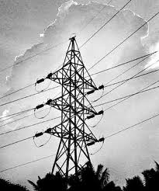
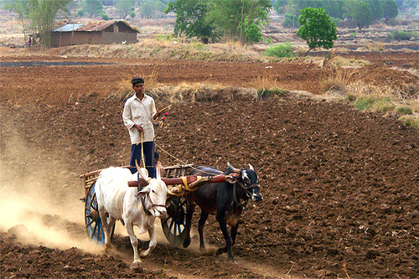
TRANSPORT
AGRICULTURE
POWER
INDUSTRY
Notes:
STAKEHOLDERS

Slide 23
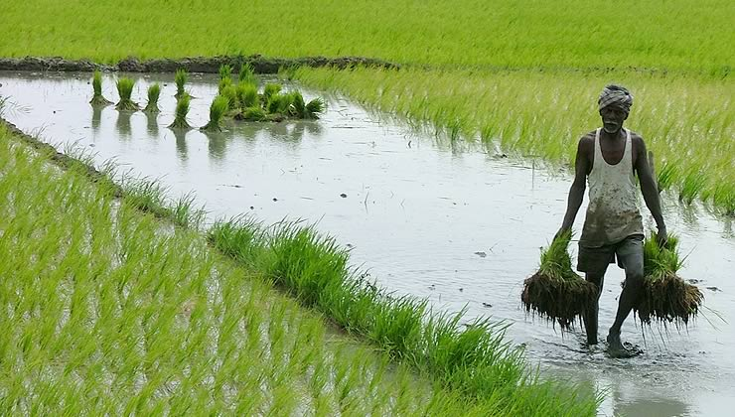
IMPACT ASSESMENT : AGRICULTURE
Farmers will get a legitimate share in the final value of their produce
Facilitate free movement of agricultural produce between the States
Competition in supply of inputs such as seeds, fertilizers etc
Realistic pricing, conservation of input use and more rational crop selection.
Notes:
There is huge potential to advance competition in the agricultural sector both from the demand as well as from the supply side. On the demand side, the
model Agricultural Produce Marketing Committee Act is likely to provide a framework, which will abolish the ’mandi’ tax and permit the farmers to sell their
produce outside the ‘mandi’ so that the farmers will get a legitimate share in the final value of their produce. It will also facilitate free movement of
agricultural produce between the States. This is expected to help the agriculture sector to grow faster and also augment rural income and
employment.
On the supply side, competition in supply of inputs such as seeds, fertilizers, pesticides and credit may be augmented which will facilitate timely, effective
and adequate supply of agricultural inputs in the country and will lead to greater efficiency through more realistic pricing, conservation of input use and
more rational crop selection.

Slide 24
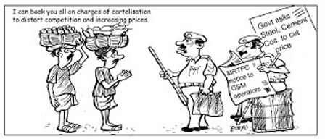
CONCLUSION
Notes:
Overall a good policy but certain issues need to be addressed in time so as to make it an effective policy.
The policy as such is in limbo.

Slide 25
THANK YOU

